Slide 1



Optimal Planning of Emergency Evacuations for Electric Vehicles Leveraging Equivalent Circuit Models
Authors
Joseph Moyalanª, Ricardo de Castroª, Shuang Fengª, Xuchang Tang^{b}, Xinfan Lin^{b}, Scott Moura^{c}
University of California, Mercedª
University of California, Davis^{b}
University of California, Berkeley^{c}

Slide 2
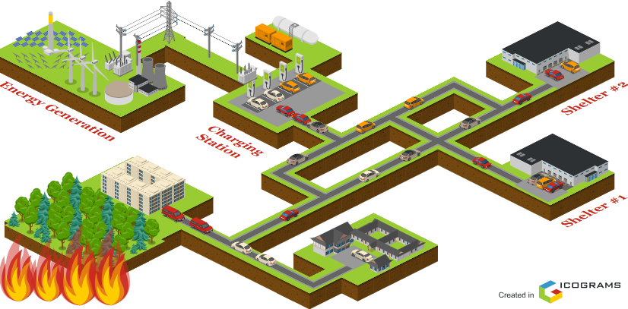

Emergency evacuation problem for Electric Vehicles^{[1]}
Destination
Origin
Evacuees
EVs
1
[1] Bell, Michael GH, and Yasunori Iida. Transportation network analysis. 1997.

Slide 3
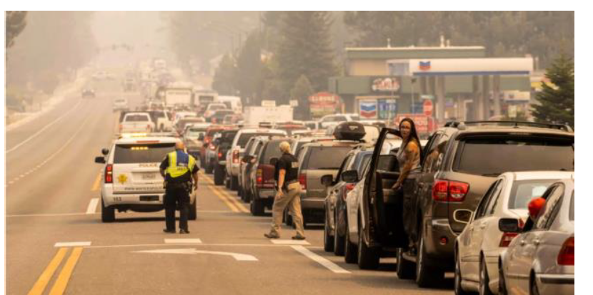


Emergency evacuation problem for Electric Vehicles^{[1]}
Traffic Congestion
Power Outage
Charging Congestion
Lake Toahoe, Caldor Fire Source: Josh Edelson, AFP
Charger 1
Charger 2
Charger 3
Charger 4
Need of optimal vehicle routing and charging algorithm to alleviate these challenges
Evacuees
EVs
1
[1] Bell, Michael GH, and Yasunori Iida. Transportation network analysis. 1997.

Slide 4
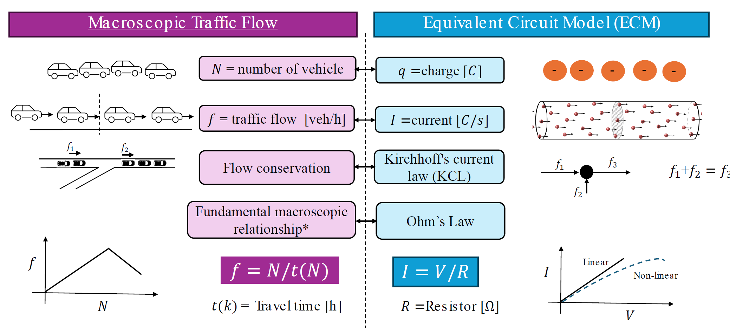
Equivalent Circuit Model (ECM) for Transportation Network^{[2]}
2
[2] Wunsche, Stefan, et al. "Electro-thermal circuit simulation using simulator coupling." IEEE Transactions on very large-scale integration (VLSI) systems 5.3 (2002): 277-282.

Slide 5
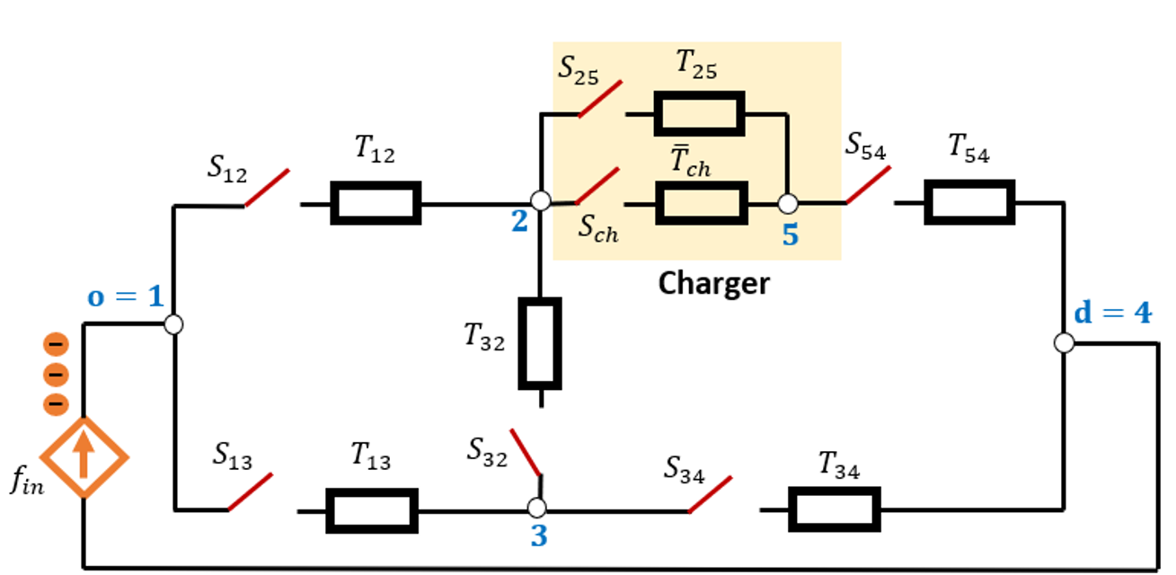
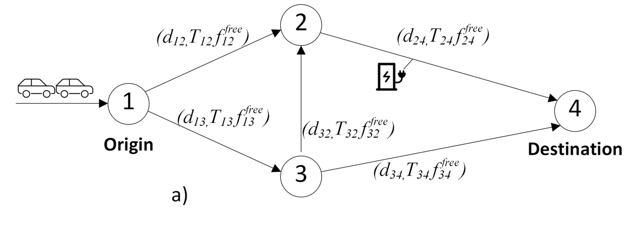

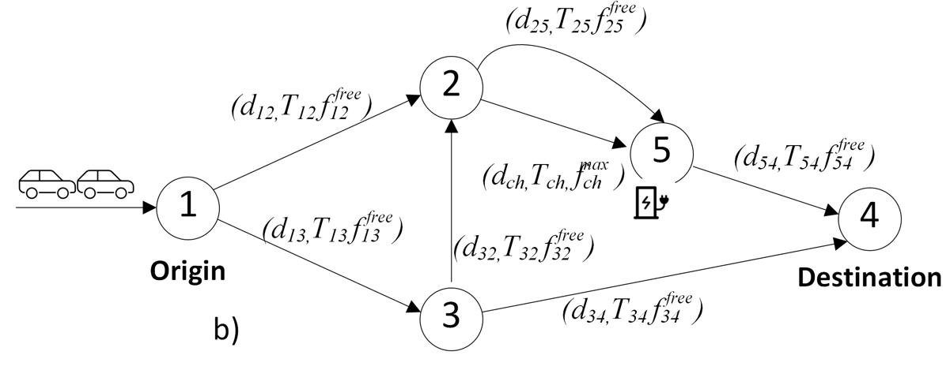

Equivalent Circuit Model (ECM) for Transportation Network
No charging
ECM framework
Choose charging
Decision variables are $S_{ij}$ and $S_{ch}$ which take Boolean values $\{0,1\}$
3

Slide 6
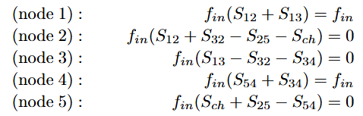




Integer Linear program (ILP) for Emergency Evacuation
$$I_{12}+I_{13}=I_{in}$$
$$I_{12}+I_{32}−{I_{25}−I}_{ch}=0$$
$$I_{13}−I_{32}−I_{34}=0$$
$$I_{54}+I_{34}=I_{in}$$
$$I_{ch}+I_{25}−I_{54}=0$$
$$⇓$$
ECM framework
$$\min_{S,S^{ch}}{T^{⊤}S+T_{ch}^{⊤}S^{ch}}$$
$$s.t. A_{KCL}S+A_{KCL}^{ch}S^{ch}=B_{KCL}$$
$$r^{0}−D^{⊤}S+d_{ch}^{⊤}S^{ch}≥0$$
Total evacuation time
Network constraints
Driving range constraint
4

Slide 7

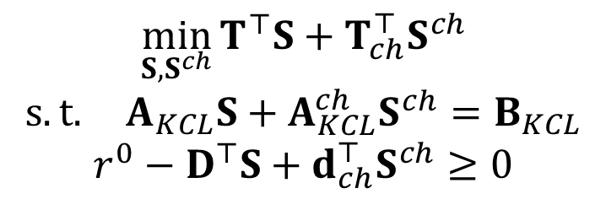
Mixed Integer Linear program (MILP) for multiple (od)-pairs
Worst evacuation time
$$\min_{S_{m},S_{m}^{ch},t_{evac,m},γ}{γ}$$
$$s.t. A_{KCL}S_{m}+A_{KCL}^{ch}S_{m}^{ch}=B_{KCL,m}$$
$$r_{m}^{0}−D^{⊤}S_{m}+d_{ch}^{⊤}S_{m}^{ch}≥0$$
$$T^{⊤}S_{m}+T_{ch}^{⊤}S_{m}^{ch}=t_{evac,m}$$
$$t_{evac,m}≤γ$$
$$0≤\sum_{m}{f_{in,m}S_{m}≤F_{T}^{free}}$$
$$0≤\sum_{m}{f_{in,m}S_{m}^{ch}≤f_{ch}^{max}}$$
$$m∈𝒪𝒟$$
Network, driving range and evacuation time constraint for each od – pair.
$$\min_{S,S^{ch}}{T^{⊤}S+T_{ch}^{⊤}S^{ch}}$$
$$s.t. A_{KCL}S+A_{KCL}^{ch}S^{ch}=B_{KCL}$$
$$r^{0}−D^{⊤}S+d_{ch}^{⊤}S^{ch}≥0$$
Road free flow capacity
ILP
Port capacity of charging station
MILP
5

Slide 8
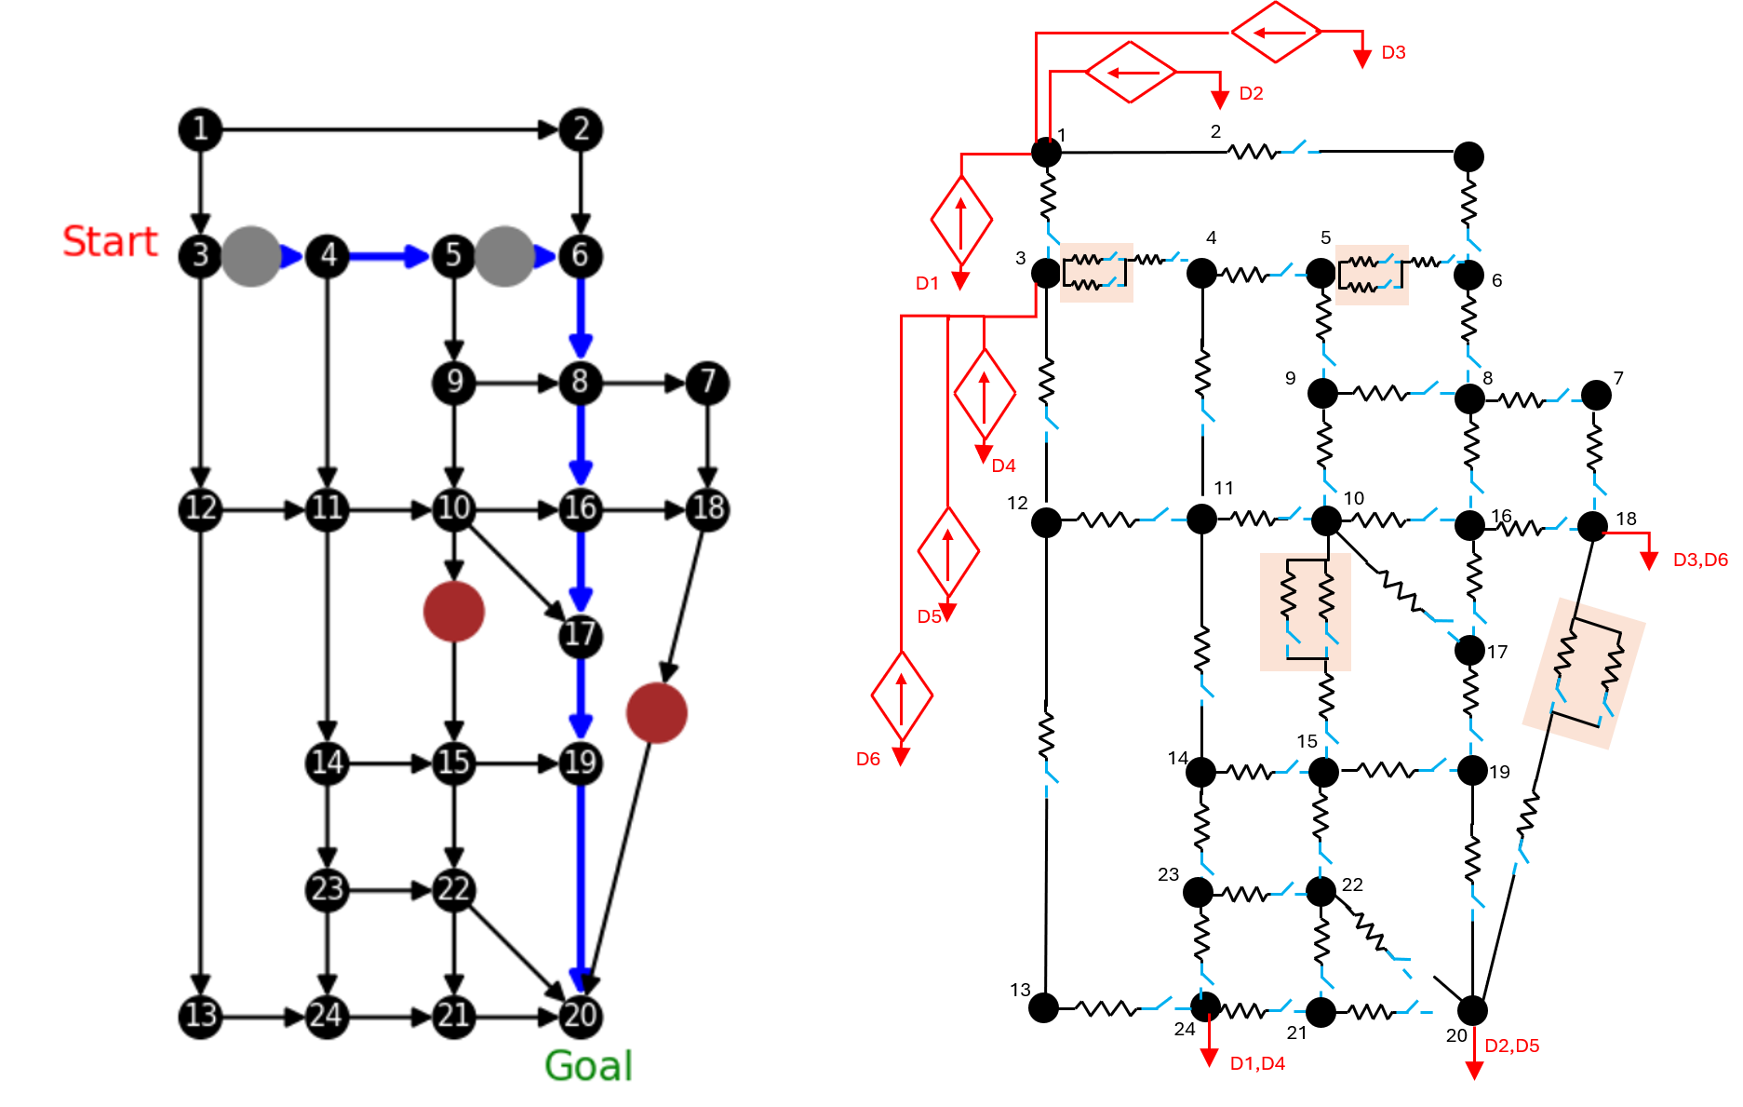

Sioux Falls Transportation Network^{[3]}
Parameters
Number of nodes: 24
Number of links: 38
Number of (od)-pairs: 6
Charging speed: 20 kW
$f_{ij}^{free}$: 1000 vehicles/hr
$f_{in}$: 50 vehicles/hr
Sioux falls network
ECM framework
6
[3] Sun, Xiaotong, Zhibin Chen, and Yafeng Yin. "Integrated planning of static and dynamic charging infrastructure for electric vehicles." Transportation Research Part D: Transport and Environment 83 (2020): 102331.

Slide 9
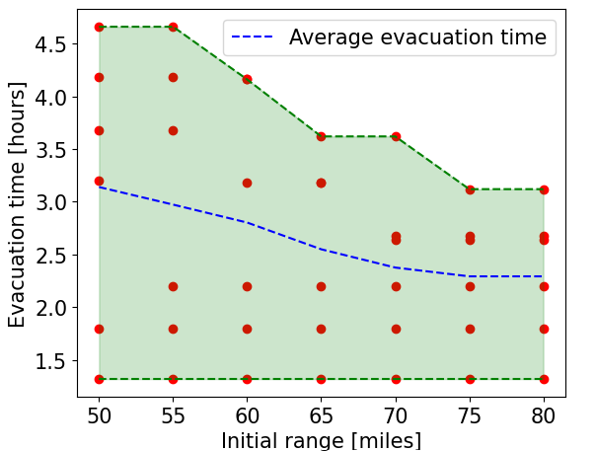
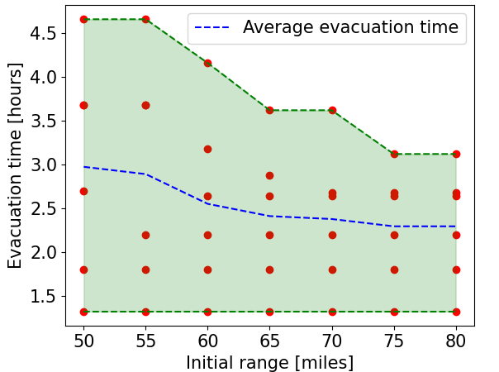
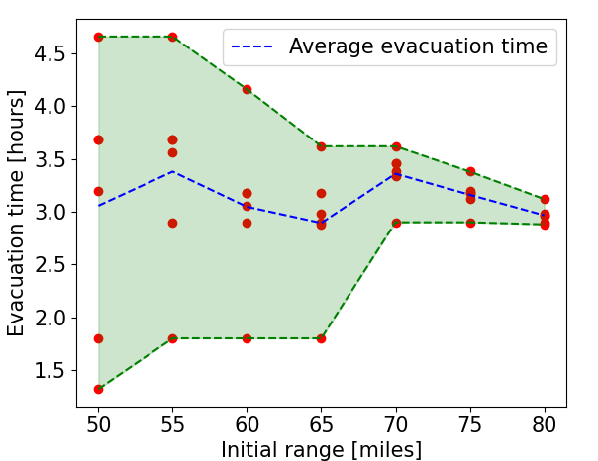
Sensitivity Analysis with different cost metrics
Minimizing worst evacuation time
Minimizing average evacuation time
Minimizing deviation between all evacuation time
7

Slide 10
Sensitivity Analysis with different cost metrics
Worst evacuation time decreases as we increase initial range.
Electric vehicles with sufficient initial range don’t need to stop at charging station.
Minimizing worst evacuation time
7

Slide 11
Sensitivity Analysis with different cost metrics
Average evacuation time (shown by dash blue line) starts at 3.2 hours in left plot whereas the value starts at 3 hours in right plot.
Minimizing worst evacuation time
Minimizing average evacuation time
7

Slide 12
Sensitivity Analysis with different cost metrics
Deviation in the evacuation times of the six od - pairs decreases as we increase the initial range.
The optimization enforces longer routes for certain OD pairs to reduce evacuation time deviations, resulting in a higher average evacuation time compared to the other two metrics.
Minimizing deviation between all evacuation time
7

Slide 13
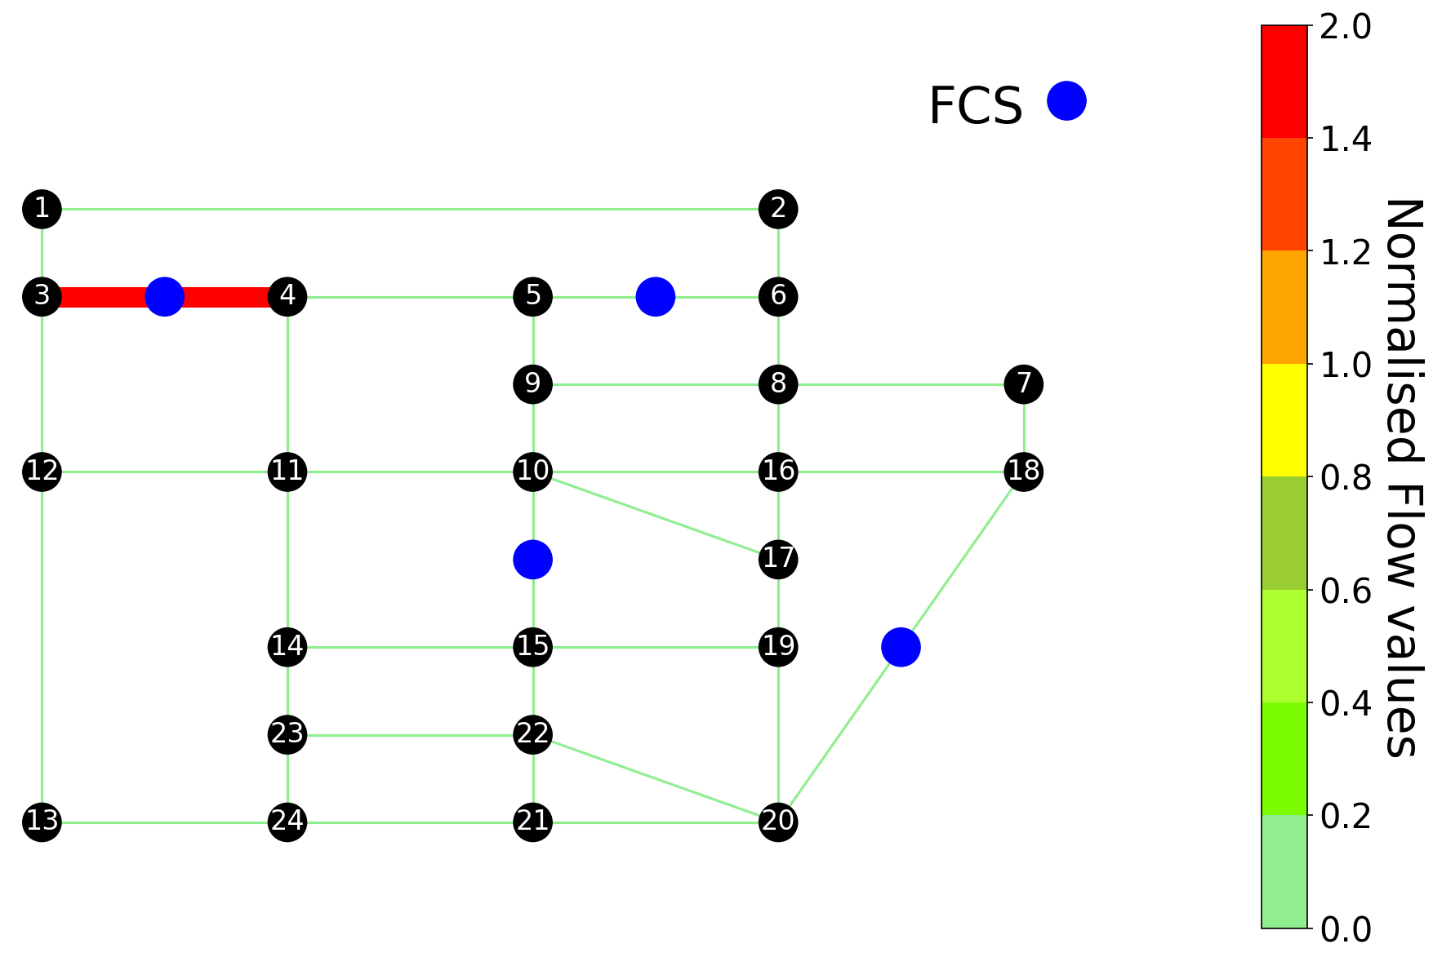
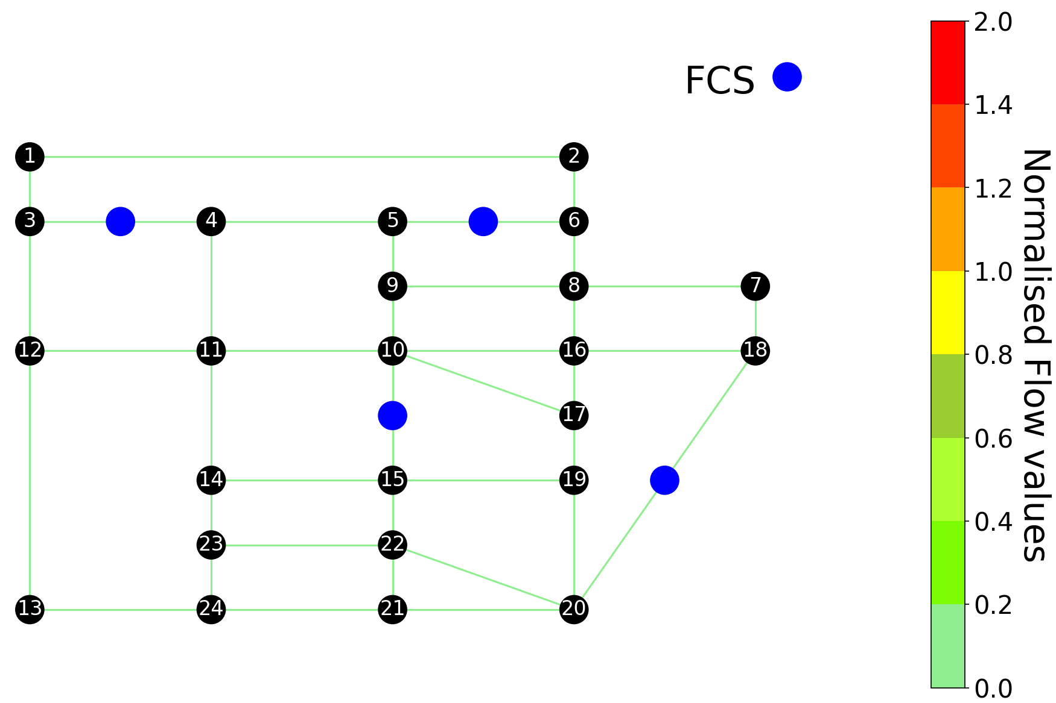

Comparison with shortest route algorithm
Expected road traffic flow for different links for shortest route evacuation plan ($A^{⋆}$ algorithm).
Expected road traffic flow for different links for ECM-based optimization evacuation plan.
8

Slide 14
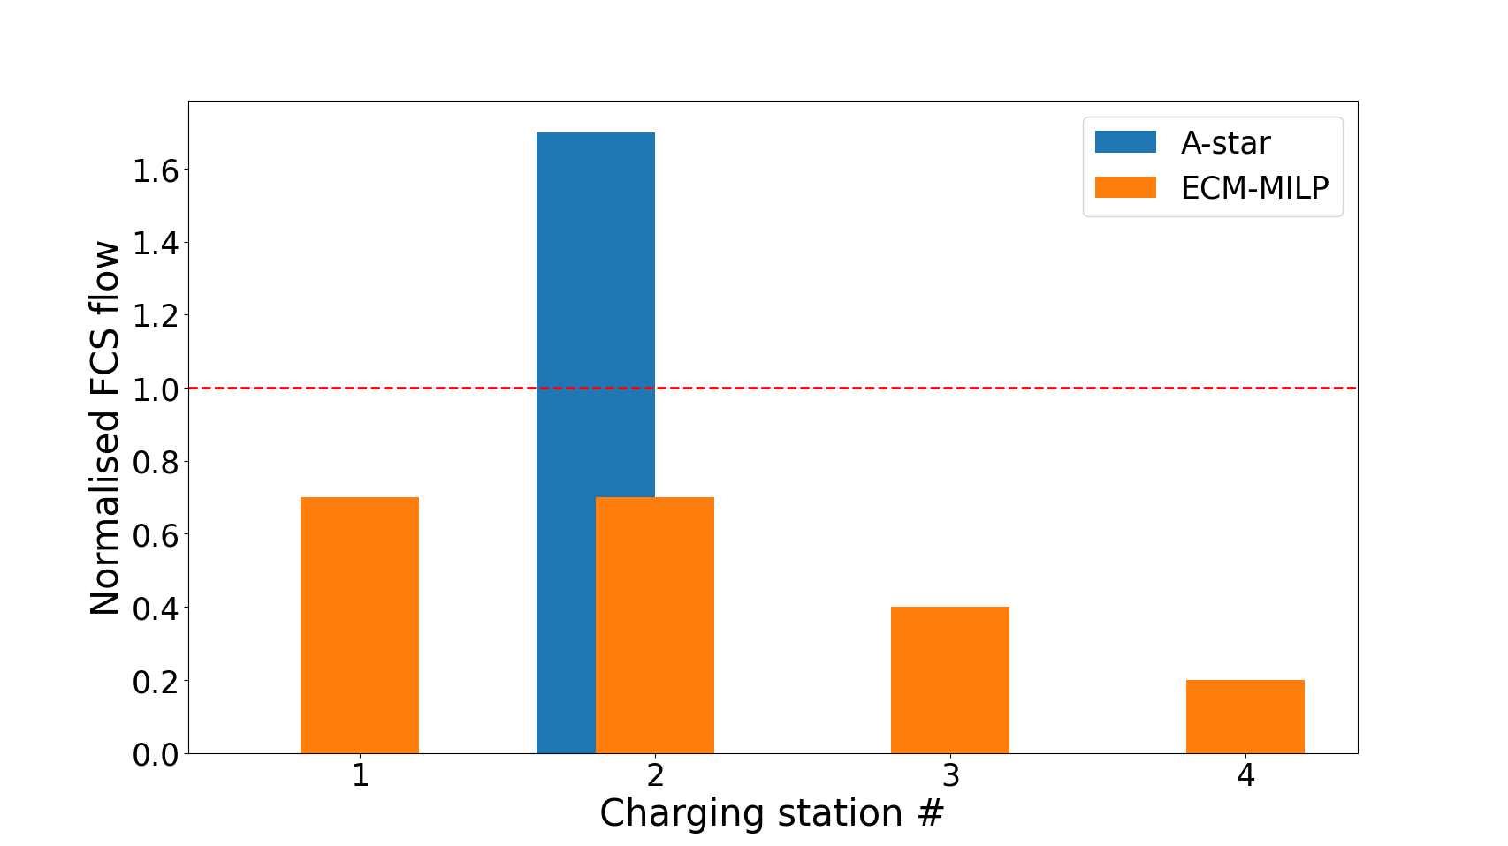
Comparison with shortest route algorithm
The shortest-route evacuation plan prioritizes short-term rewards, directing all EVs to the nearest charging station (#2), which leads to traffic congestion and queuing delays.
The ECM-based optimization adopts a global perspective, distributing EVs across all available charging stations to mitigate traffic congestion and queuing delays.
Normalized flow rate of different FCS in Sioux Falls map
9

Slide 15
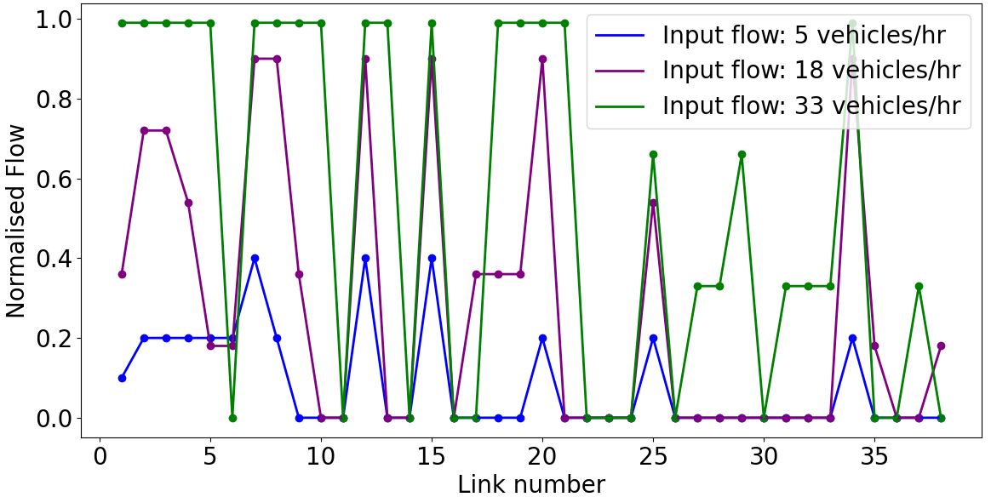

Sensitivity Analysis of road capacity of different links
Road flow capacity increases as we increase input flow of od - pairs.
As the input flow increases, a spillover effect occurs—some road links reach their free-flow limits, causing excess traffic to be diverted to previously underused links.
The normalized flow values $\left(f_{in}/f_{ij}^{free}\right)$ of different edges for the Sioux Falls network for various values of $f_{in}$. Here, $f_{ij}^{free}=100$ vehicles/hr.
10

Slide 16
Conclusions
Proposed a novel equivalent circuit model to formulate the emergency evacuation problem.
MILP framework provides routing and recharging strategies that minimize overall evacuation time while satisfying flow constraints.
Numerical simulations based on Sioux Falls demonstrate the effectiveness of the proposed approach under various evacuation scenarios.
Future Work
Integration of the ECM with mobile chargers and real-time evacuation planning.
Incorporating Bureau of Public Roads (BPR) function into the ECM model-based optimization.
Converting the charging station stoppage time from a parameter to a decision variable.
11

Slide 17


Thank you jmoyalan@ucmerced.edu
Google Scholar Link
LinkedIn Link
12

Slide 18
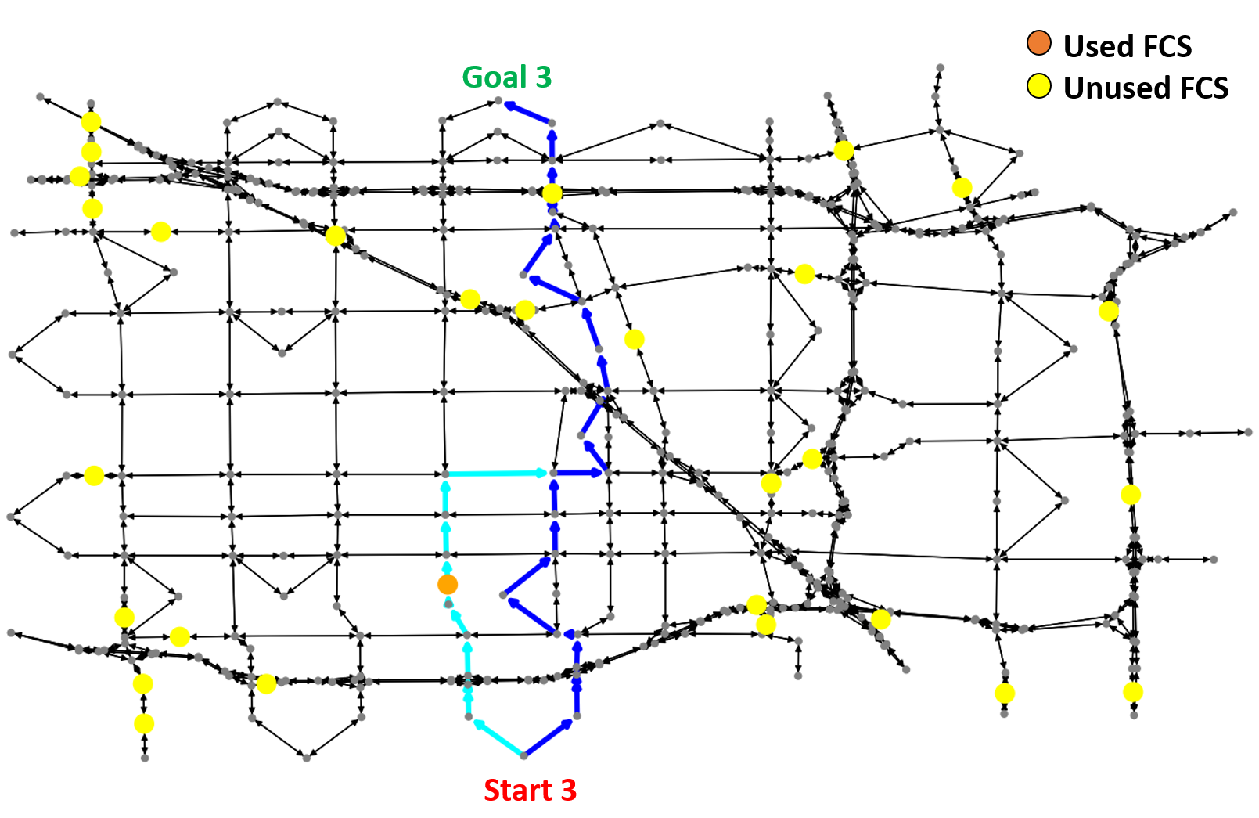

Anaheim Transportation Network^{[2]}
Parameters
Number of nodes: 416
Number of links: 914
Number of (od)-pairs: 6
Charging speed: 50 kW
$f_{ij}^{free}$: 1800-12600 vehicles/hr
$f_{in}$: 100 vehicles/hr
[2] Transportation networks for research core team. Technical report, Transportation Networks for Research. URL https://github.com/bstabler/TransportationNetworks.
13

Slide 19
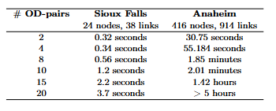
Computation time comparison
14

Slide 20
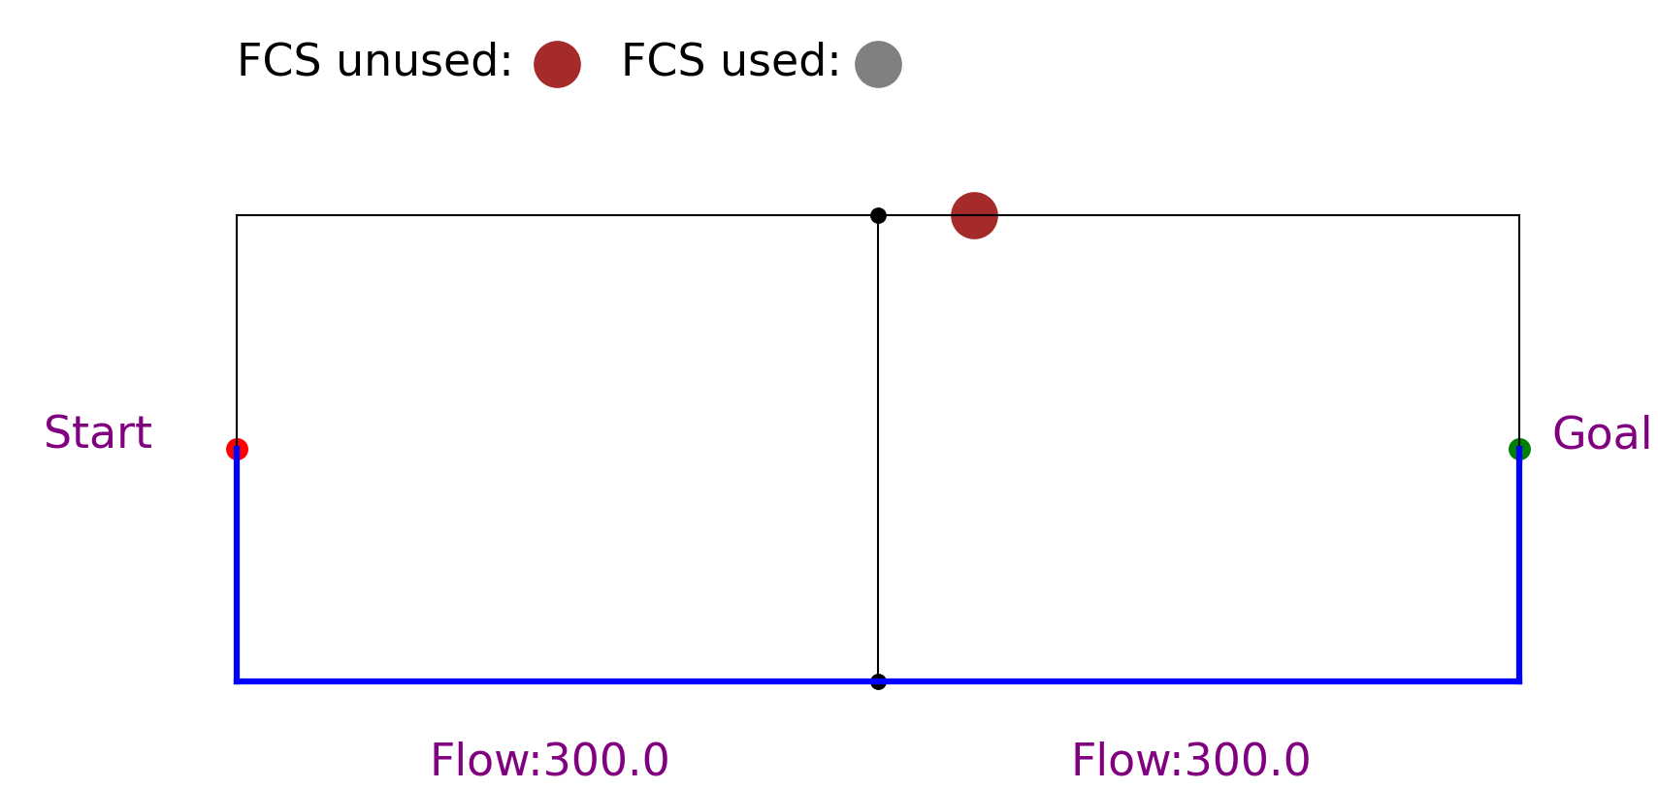
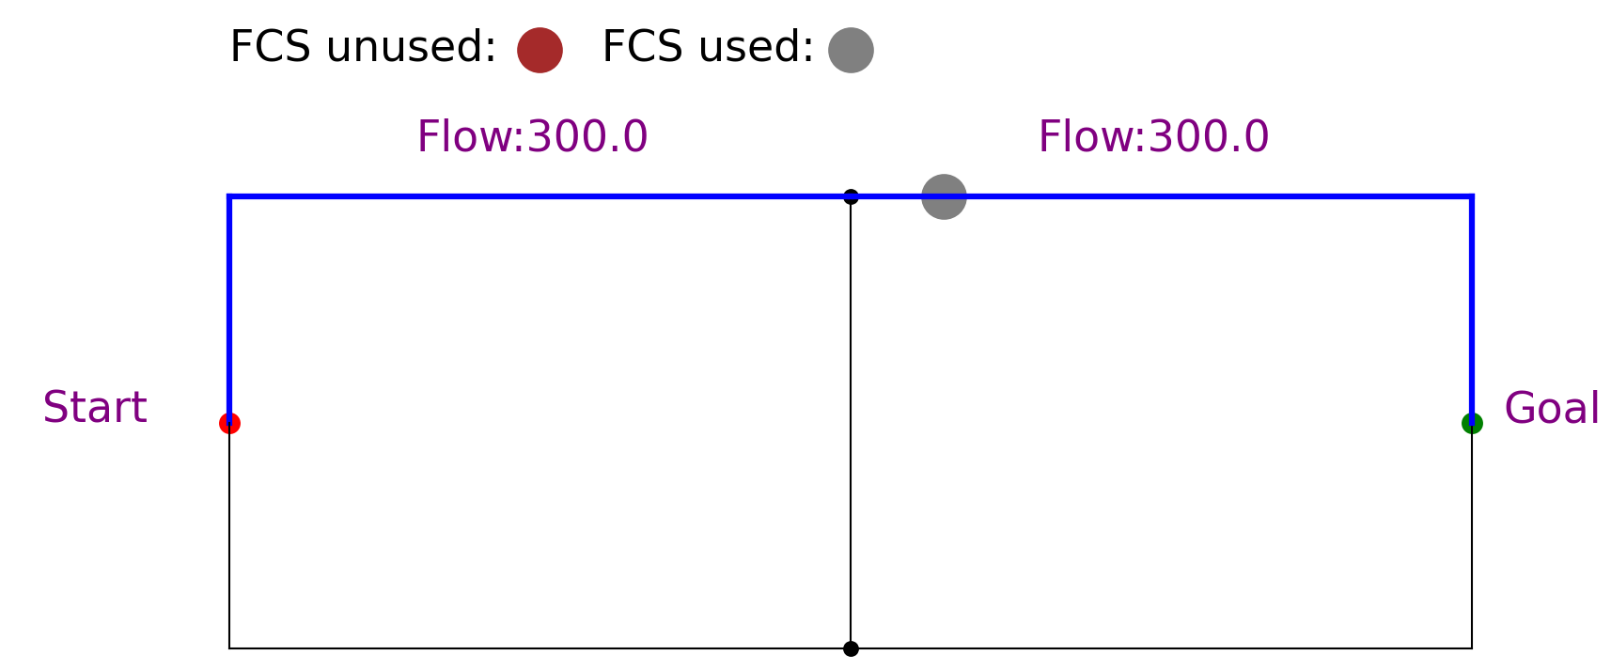
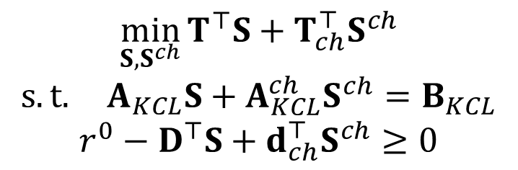
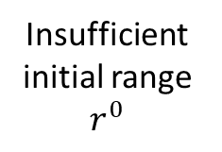
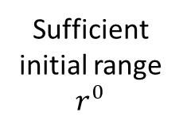
Integer Linear program (ILP) for Emergency Evacuation
Sufficient initial range $r^{0}$
$$\min_{S,S^{ch}}{T^{⊤}S+T_{ch}^{⊤}S^{ch}}$$
$$s.t. A_{KCL}S+A_{KCL}^{ch}S^{ch}=B_{KCL}$$
$$r^{0}−D^{⊤}S+d_{ch}^{⊤}S^{ch}≥0$$
Insufficient initial range $r^{0}$
15

Slide 21
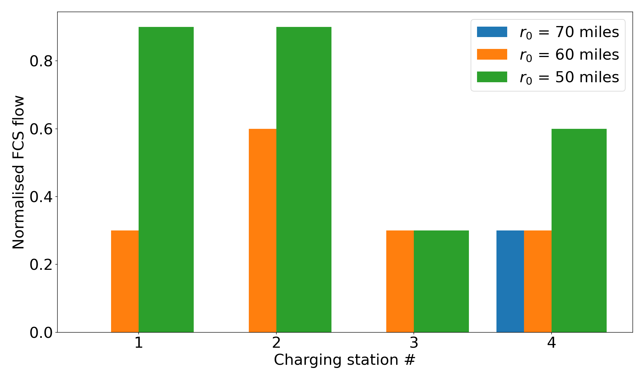

Sensitivity Analysis of port capacity of different charging locations
The normalized flow values $\left(f_{in}/f_{ch,(i,j)}^{max}\right)$of fixed charging stations (FCS) for the Sioux Falls network for various values of${ r}^{0}$.
16

